Slide 1
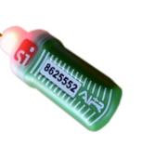




FINISH
Connection
LTE Modem
Signal
Battery
dati

Slide 2
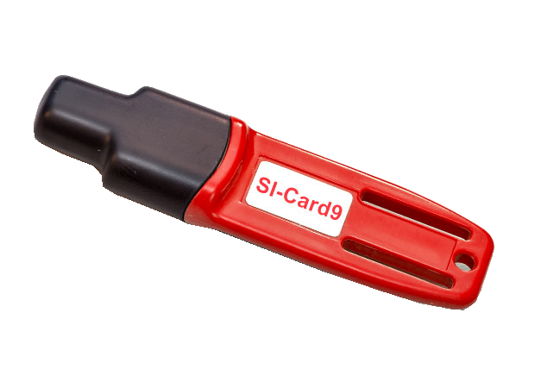
FINISH
SI SRR
Connection
LTE Modem
Signal
Battery
dati

Slide 3
